Slide 1

Oxford/Cambridge
Summer Courses
Workshop
Dr Anthony ’Skip’ basiel
abasiel@gmail.com
http://abasiel.wordpress.com

Slide 2
Overview
Presenter introduction search
1-minute essay
Paper airplane challenge
Sherlock Holmes mystery
Developing observational skills
Attention Test
Perception
Colour Psychometrics
Online Physics Problem

Slide 3

Search for Dr Anthony ‘Skip’ Basiel
In teams:
Find at least 2 true facts about your Tutor that shows why they are good to facilitate this module.
Game:
Each team gets 1 point for a correct answer.
Winner = 3 points first
Prize
First on half-way break

Slide 4

1 Minute essay
In one minute write something you have learnt this summer. It can be from a lesson, or informal from a social event, or just exploring Cambridge.
Next- share your wisdom with a friend. You may want to make a change.
Share with the class?

Slide 5

paper airplane challenge
In teams:
research,
design,
develop
and produce a paper airplane.
What important questions do you need to ask to successfully complete this task?

Slide 6
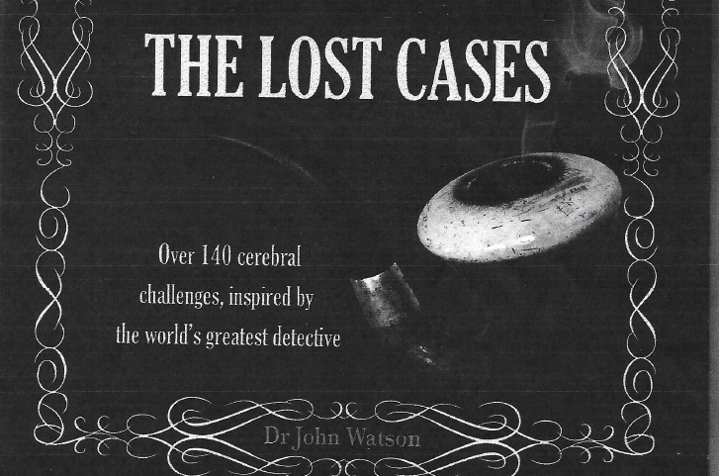
Use Your Deductive reasoning in pairs

Slide 7
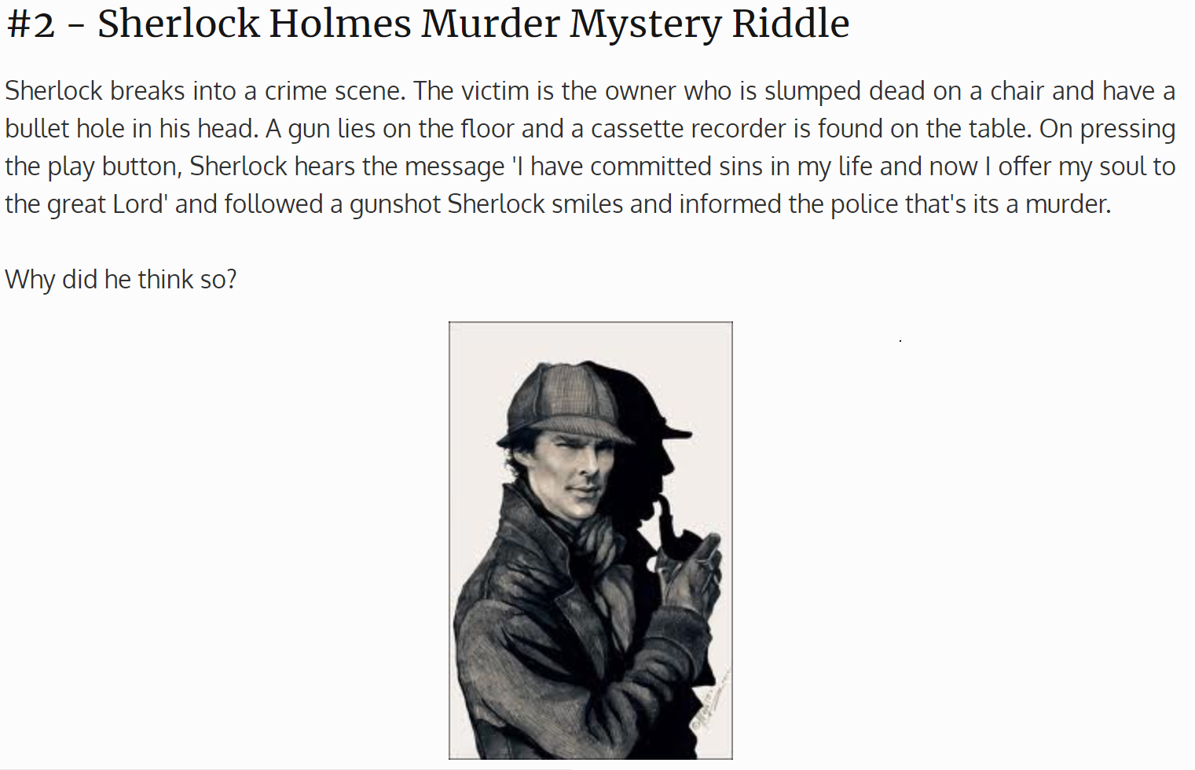
http://www.briddles.com/riddles/sherlock-holmes-questions

Slide 8
http://www.briddles.com/riddles/sherlock-holmes-questions
How can a dead person rewind back the tape himself?

Slide 9

http://www.briddles.com/riddles/sherlock-holmes-questions
#18 - Baker Street Murder Mystery
A crime was committed at Baker Street. Ibrahim Dakota who was shot in stomach was the main suspect. Sherlock questioned the suspect.
The conversation started as:
Sherlock: What’s your story Ibrahim?
Ibrahim: I was walking around Baker Street and suddenly a man from back shot me. I ran as fast as I could to save my life.
Sherlock: That is enough (and asked the police to arrest him).
Why did Sherlock think he was the murderer?

Slide 10
http://www.briddles.com/riddles/sherlock-holmes-questions
#18 - Baker Street Murder Mystery
A crime was committed at Baker Street. Ibrahim Dakota who was shot in stomach was the main suspect. Sherlock questioned the suspect.
The conversation started as:
Sherlock: What’s your story Ibrahim?
Ibrahim: I was walking around Baker Street and suddenly a man from back shot me. I ran as fast as I could to save my life.
Sherlock: That is enough (and asked the police to arrest him).
Why did Sherlock think he was the murderer?

Slide 11
http://www.briddles.com/riddles/sherlock-holmes-questions
#18 - Baker Street Murder Mystery
A crime was committed at Baker Street. Ibrahim Dakota who was shot in stomach was the main suspect. Sherlock questioned the suspect.
The conversation started as:
Sherlock: What’s your story Ibrahim?
Ibrahim: I was walking around Baker Street and suddenly a man from back shot me. I ran as fast as I could to save my life.
Sherlock: That is enough (and asked the police to arrest him).
Why did Sherlock think he was the murderer?
If shot from back, how can he get the injury in the front in the stomach?
Therefore a fake story.

Slide 12
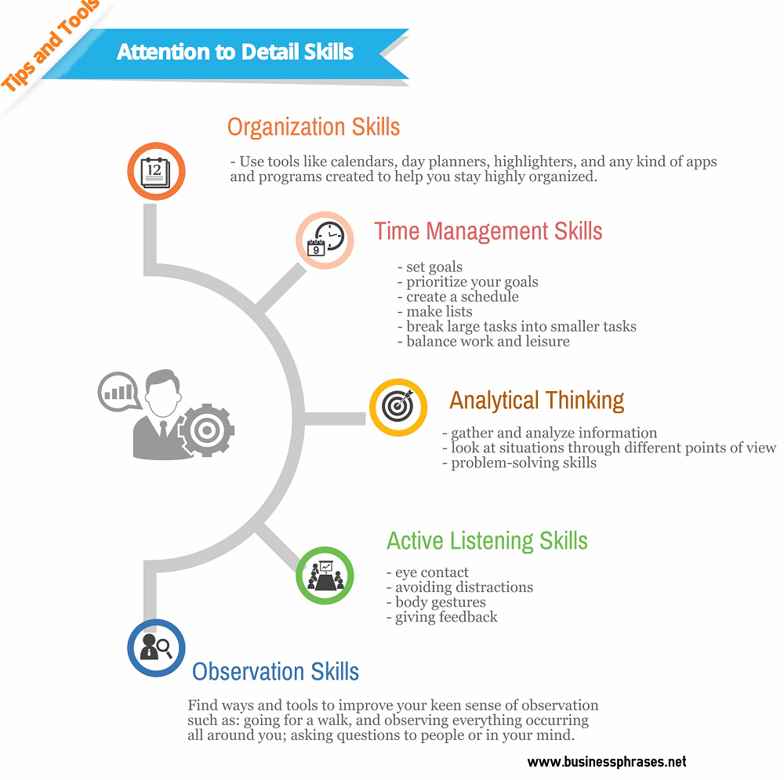
Developing Observation
Skills

Slide 13
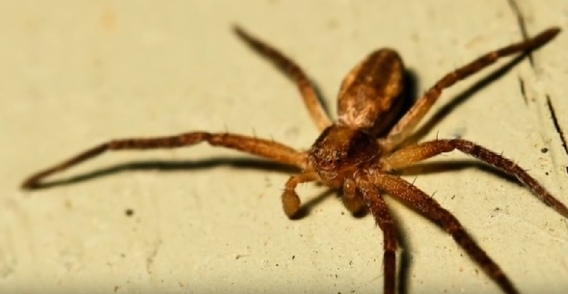
Developing Observation Skills
YouTube https://youtu.be/CFmj_NY5tvg
Observation & Inference

Slide 14
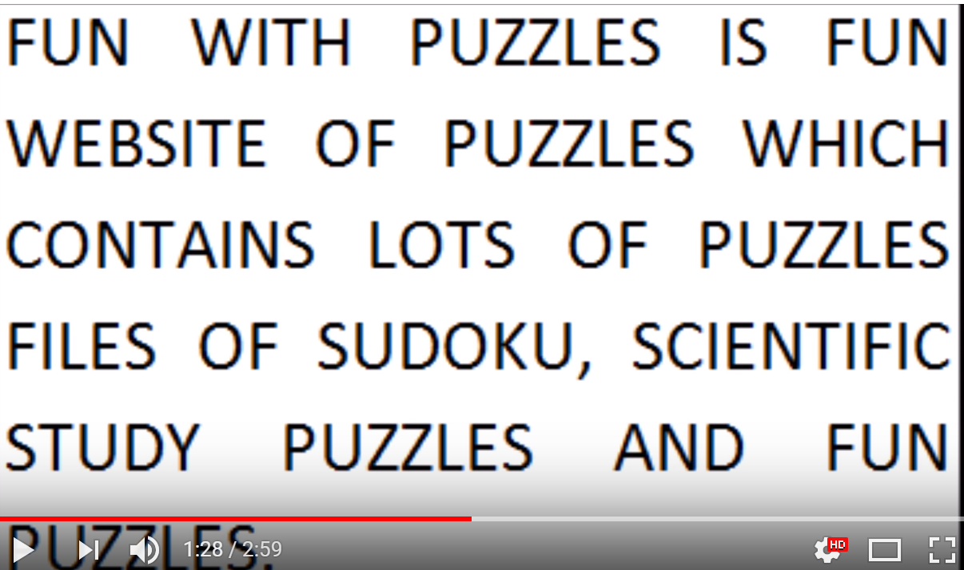
Developing Observation Skills
Try this test to measure your observation skills. How many ‘F’s?
See the video: https://youtu.be/yyF5ATC5-XQ

Slide 15
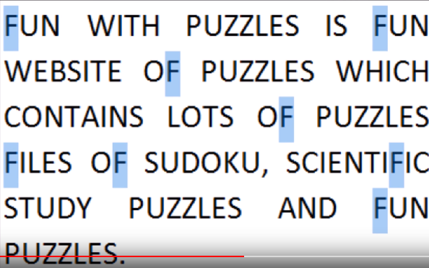
Developing Observation Skills: 8 Fs

Slide 16
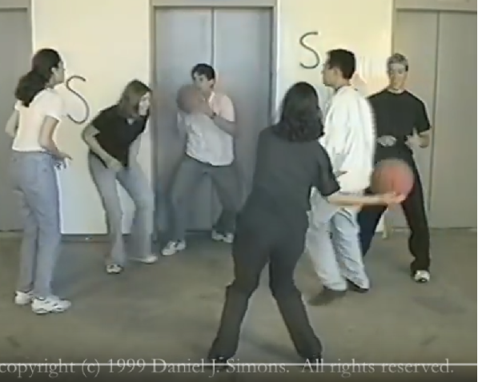
Selective Attention test
See: https://www.youtube.com/watch?v=T8vAT7sWEow

Slide 17

perception
Observation is linked to perception.
How many senses do we have? – Discuss with the whole class
What is Proprioception?

Slide 18
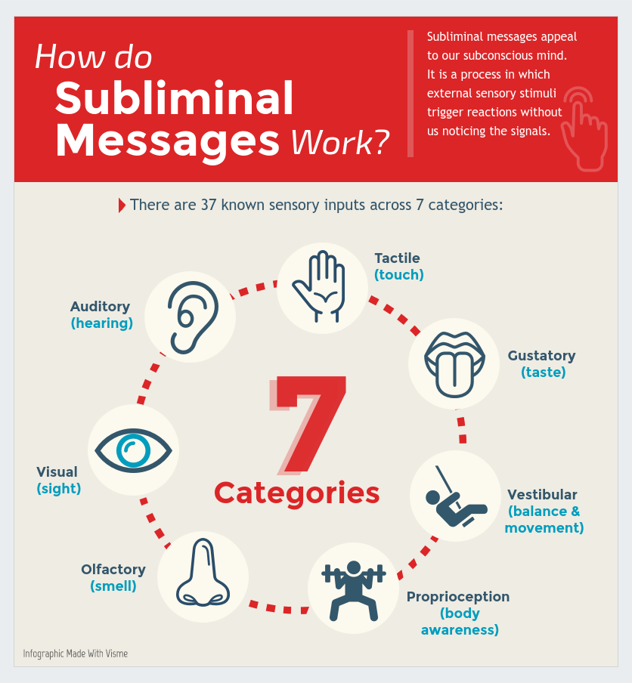
perception

Slide 19

perception
Do the pencil test:
Take your pen and look down while making a clockwise circle.
Keep circling but hold the pen up so you are looking at it from beneath.
????? Is it still going in the same direction, or is it counter-clockwise now?
See my YouTube video: https://youtu.be/m3EsRvF0y8M

Slide 20
Colour psychometrics
Do paper survey
Identify your colour
Follow-up after at:
https://www.colorcode.com/free_personality_test/
Note: You don’t have to register

Slide 21

Complete the Questionnaire
Add up the numbers of the Letters (A,B,C and D)
Put result in order of the highest to the lowest
List the letters in order
The highest number represent the set of personality traits your most like
The lowest number represent the least personality trait you are least like
Notes:
Complete the questionnaire:
Instruction:
Add up the number of the letters ABCD and add the number under each letter
Put result in order highest to the lowest
List ABCD in order,
Say to students the highest number represent the set of personality traits your most like.
And the lowest number represent the least personality trait you are least like.
To help you explore your personality traits lets complete the questionnaire.
The questionnaires shows 9 sets of words, taking the first set of words, 1 chose which word that best describe you
Circle it and continue doing the same 2 to 9 for the other 8 sets of words
Now when you finished add the number of A’s B’s C’s and D’s
Write the total below then put the A’s B’s C’s and D’s putting the highest first and lowest in order

Slide 22
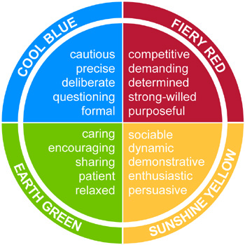
Introduction To Colour Energy
Notes:
Explain how the personality traits fits the colours
The result of your questionnaire shows you which colour energies you use most and least like
Video on!!
Then Yvonne will explain ……

Slide 23
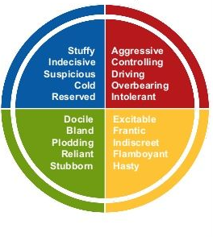
Colour Energies Explained Bad Day

Slide 24
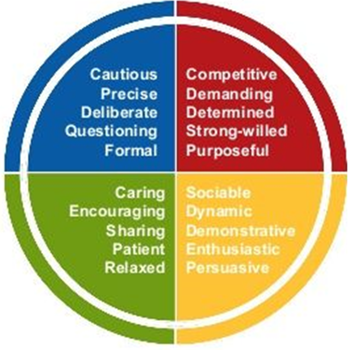
Colour Energies Explained Good Day

Slide 25
Project Skills
Matching Personality Traits
Cool Blue
Sunshine Yellow
Fiery Red
Earthy Green
Note taker
Researcher
Data analyst
Presenters
Report writer
Team motivation
Directors
Decision maker
Project Managers
Peace keeper
Team spirit
Positive direction

Slide 26
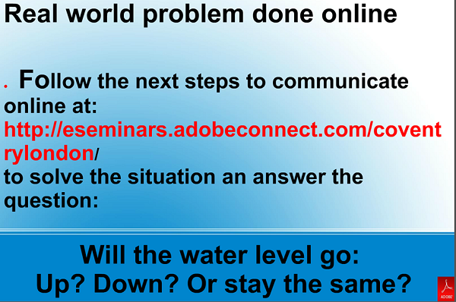
Physics problem

Slide 27
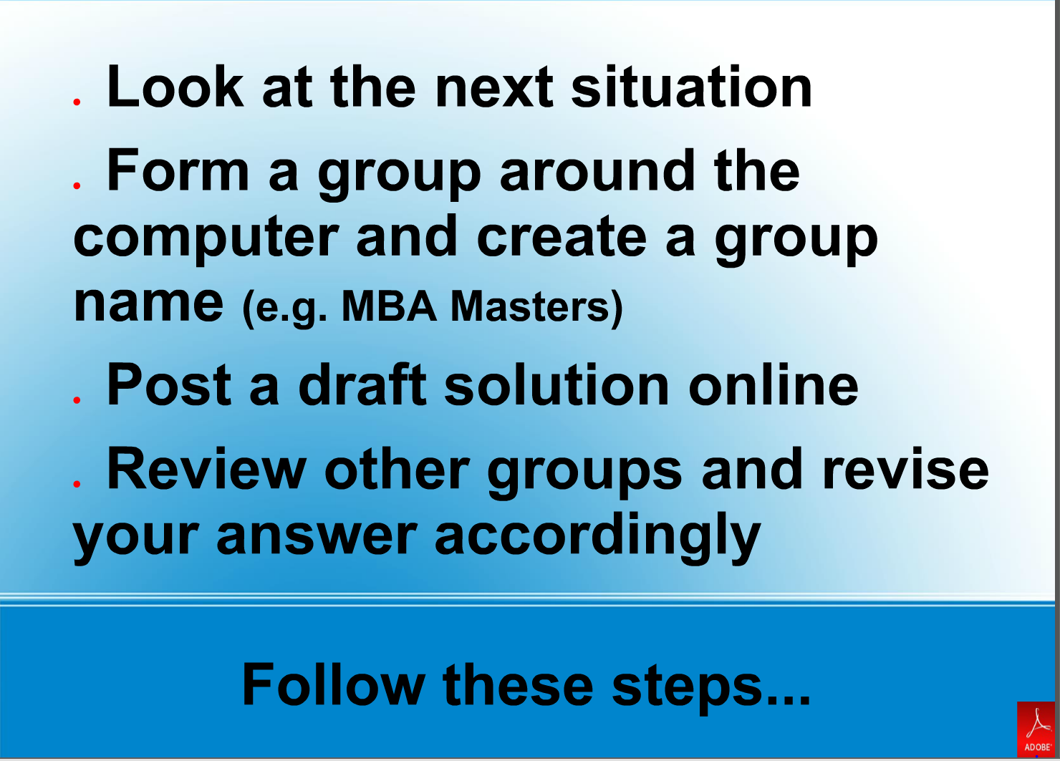
Physics problem

Slide 28
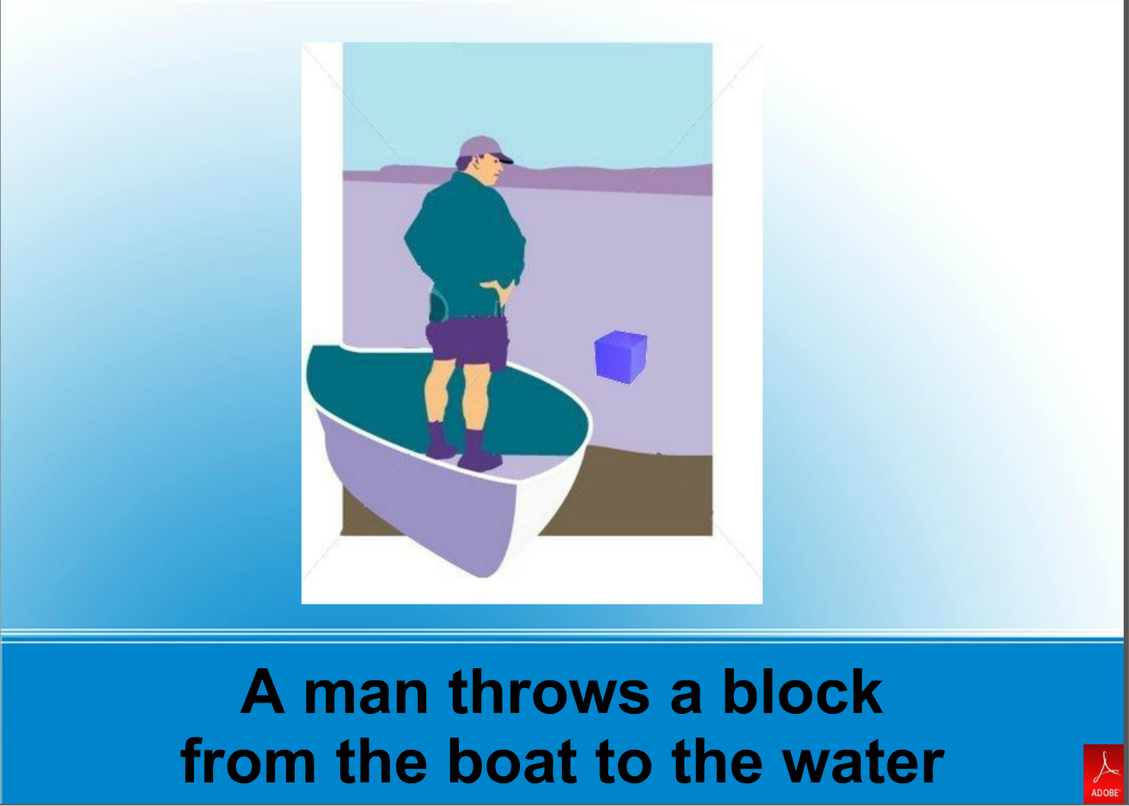
Physics problem

Slide 29
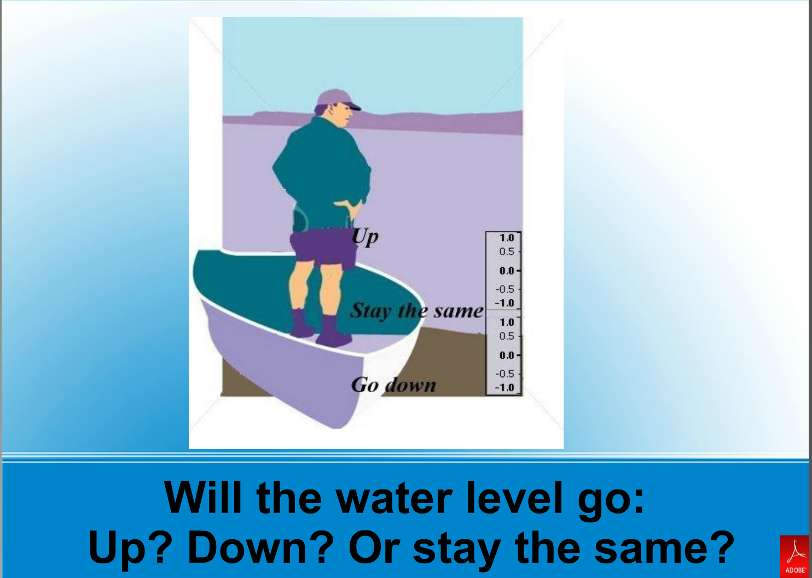
Physics problem

Slide 30

Fuzzy knowledge & solutions
Not all situations will have a clear answers. The answers may fall somewhere on a range or spectrum of solutions that can change over time as new information comes available. (E.g. the earth is no longer considered flat )
Please see my website:
http://abasiel.wordpress.com
or eMail any questions
abasiel@gmail.com

